Slide 1

Emerging Game Trends
MOBALYTICS PITCH
Notes:
Good Morning, good evening wherever you may be, My name is Disty Mahmud, I am a dual degree student at Duke and Duke Kunshan University studying Computation and Design and today I will be presenting my market research findings.
Here is a general overview of what I will be talking about: first a brief overall summary, then the games I researched, finally my recommendations.
So what is the overall problem? Mobalytics, an esports player analytics company is looking for emerging games and genres to help expand, specifically player bases that are willing to use their product. I researched two different types of games: Mobile centric ones and a PC-centric one. The Mobile centric had the shared theme of being gacha games, which are free-to-play games that entice players with in-game purchases, usually a character, and the other characteristic being they are both RPG. Meanwhile, The PC-centric game is a rhythm game that has been popular for many years. My recommendations can be summed up into proposing one, Mobalytics to implement a mobile-friendly app or program, and two, the potential expansion of the customer base with gacha games.
The first game I researched is the PC Centric rhythm game called, Osu! Which is known for it’s addictiveness and difficulty. The general player base is very competitive and improvement-driven. They are motivated by rankings, which are displayed inside the game itself when you select a certain song or “beat map”, they are also motivated by the need to improve themselves. The game will show you your previous scores achieved, so from D to S, with S being the highest you try to achieve perfection. There are also many other improvement-based tools such as accuracy graphs. The players can also be competitive as the Twitch category has around 2.2 million followers and there are esports events held for Osu! And here you can see an example of a beat map and how difficult the game is as this is not even the highest difficulty.
The next game is the mobile gacha game, Limbus Company developed by South Korean indie Developers, Project Moon. The player base of Limbus Company is really mellow, the subreddit is filled out with mild discussions and fanart, with only the occasional complaint or rage. This is because most players are focused on the story and the characters, although many seem to not spend or be heavy spenders. There is no competitive scene for Limbus Company which makes sense as many seem to indicate a dislike for the game’s fighting mechanics which has you link your randomly generated skills every turn in order to fight.
The last game is Arknights, I already knew of this game before as the player base is very vibrant and passionate. One thing to note is that the community is divided between the Chinese server and the global one, however, I will be focusing on the global player base. Many players are motivated by the over 200 characters in the game, the different stages, and the story is also praised by many. The scene can be quite competitive as many people I found are quite obsessed with their account stats and theory-crafting, which is using mathematical analysis for optimizing gameplay, usually for combat. Something interesting I found is that there is a website called arknights aceship which has all the characters in the game and their stats, and this was made by a fan, which goes to show the dedication of the player base.
My first recommendation is for Mobalytics is a mobile implementation. Through playing the gacha games I realize how many people played on their phones. I looked up some statistics and by 2027 there should be 2.2 billion mobile gamers, and mobile games have the highest revenue of all gaming devices totaling 103.50 billion, more than PC and consoles. Finally, the average revenue per user is around 87 US dollars. Mobalytics has the potential to reach a new customer base if they Implement a very comprehensive app or program for mobile games.
My second recommendation goes hand in hand with the first as many gacha games are mobile Centric. Due to their nature, they tend to generate a lot of profit and the top five gacha games average around $291 million in revenue each in 2022. Also when researching Arc Knights I found that a lot of players care about their account statistics and they do not pay just for a shining new character. And actually back then I used to play Genshin Impact, a popular gacha game, whenever a fan made a new browser program that could analyze your account it would trend and I remember seeing Twitch streamers using it and a lot of people in the chat would ask what's that website so there is a high interest in these analytical services.
My third recommendation released to the market research I did on all three games the first being OSU, which I believe only has limited potential for mobalytics to expand into as the game already has player statistics readily available so the company will need to introduce new technology if they want to expand into this game. My second game limbus company I would not recommend at all as the community is just overall not interested in players' statistics, as the game is very much indie and attracts a different audience. Finally, there is Arc Knights which I believe has high potential and eager players that would be very willing to use Mobalytics.
Here are my sources on my recommendation pages.
Here is my information and email if you have any questions or wish to contact me. Thank you very much for your attention.

Slide 2




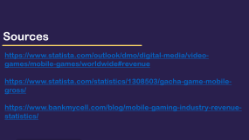
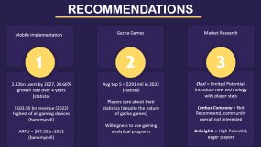
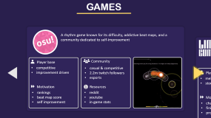
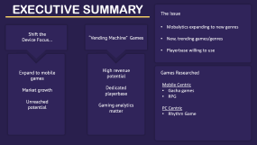
MOBALYTICS OVERVIEW

Slide 3
EXECUTIVE SUMMARY
The Issue
Mobalytics expanding to new genres
New, trending games/genres
Playerbase willing to use
Shift the
Device Focus…
“Vending Machine” Games
Expand to mobile games
Market growth
Unreached potential
High revenue potential
Dedicated playerbase
Gaming analytics matter
Games Researched
Mobile Centric
Gacha games
RPG
PC Centric
Rhythm Game

Slide 4





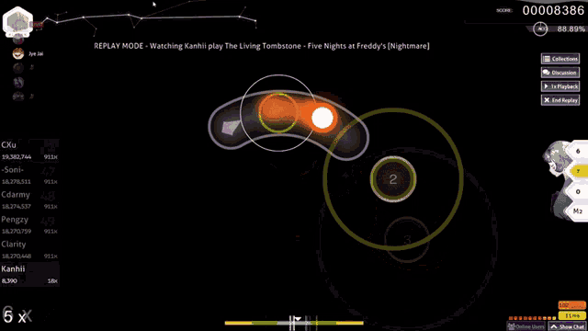


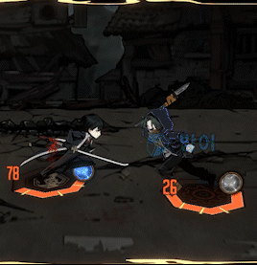
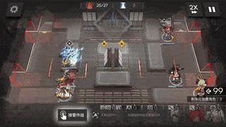


GAMES
A rhythm game known for its difficulty, addictive beat maps, and a community dedicated to self-improvement
A popular tower-defense game, heavily based on mobile. This game has become a recognized name with a vibrant community since its 2017 release.
A 2023 released turn based gacha game from the South Korean Developers, Project Moon. The game is slowly becoming known for its captivating story and characters.
Player base
Community
competitive
improvement driven
casual & competitive
2.2m twitch followers
esports
Community
Community
Player base
Player base
mellow
story-intrigued
something
something
casual & competitive
mainly casual
no competitive scene
Motivation
Resources
rankings
beat map score
self improvement
reddit
youtube
in-game stats
Motivation
Motivation
Resources
Resources
characters
finishing the stage
progressing story
reddit
youtube
arknights aceship
characters
finishing the stage
progressing story
reddit
youtube

Slide 5
GAMES
A 2023 released turn based gacha game from the South Korean Developers, Project Moon. The game is slowly becoming known for its captivating story and characters.
A popular tower-defense game, heavily based on mobile. This game has become a recognized name with a vibrant community since its 2017 release.
A rhythm game known for its difficulty, addictive beat maps, and a community dedicated to self-improvement
Player base
Community
mellow
story-intrigued
mainly casual
no competitive scene
Community
Player base
Community
Player base
competitive
improvement driven
casual & competitive
2.2m twitch followers
esports
Passionate
Vibrant
CN and Global difference
casual & competitive
Motivation
Resources
characters
finishing the stage
progressing story
reddit
youtube
Motivation
Resources
Motivation
Resources
rankings
beat map score
self improvement
reddit
youtube
in-game stats
characters
finishing the stage
progressing story
reddit
youtube
arknights aceship

Slide 6
GAMES
A popular tower-defense game, heavily based on mobile. This game has become a recognized name with a vibrant community since its 2017 release.
A 2023 released turn based gacha game from the South Korean Developers, Project Moon. The game is slowly becoming known for its captivating story and characters.
A rhythm game known for its difficulty, addictive beat maps, and a community dedicated to self-improvement
Player base
Community
Passionate
Vibrant
CN and Global difference
casual & competitive
Community
Community
Player base
Player base
competitive
improvement driven
mellow
story-intrigued
mainly casual
no competitive scene
casual & competitive
2.2m twitch followers
esports
Motivation
Resources
characters
finishing the stage
progressing story
reddit
youtube
arknights aceship
Motivation
Motivation
Resources
Resources
reddit
youtube
in-game stats
reddit
youtube
rankings
beat map score
self improvement
characters
finishing the stage
progressing story

Slide 7
RECOMMENDATIONS
Mobile implementation
Gacha Games
Market Research
1
2
3
2.32bn users by 2027, 20.66% growth rate over 4 years
(statista)
$103.50 bn revenue (2022) highest of all gaming devices
(bankmycell)
ARPU = $87.32 in 2022 (bankmycell)
Avg top 5 = $291 mil in 2022
(statista)
Players care about their statistics (despite the nature of gacha games)
Willingness to use gaming analytical programs
Osu! = Limited Potential, introduce new technology with player stats
Limbus Company = Not Recommend, community overall not interested
Arknights = High Potential, eager players
Notes:
Mention how in the Genshin fandom, whenever a new website or program came out, it would always trend and twitch comments would ask what program that is

Slide 8
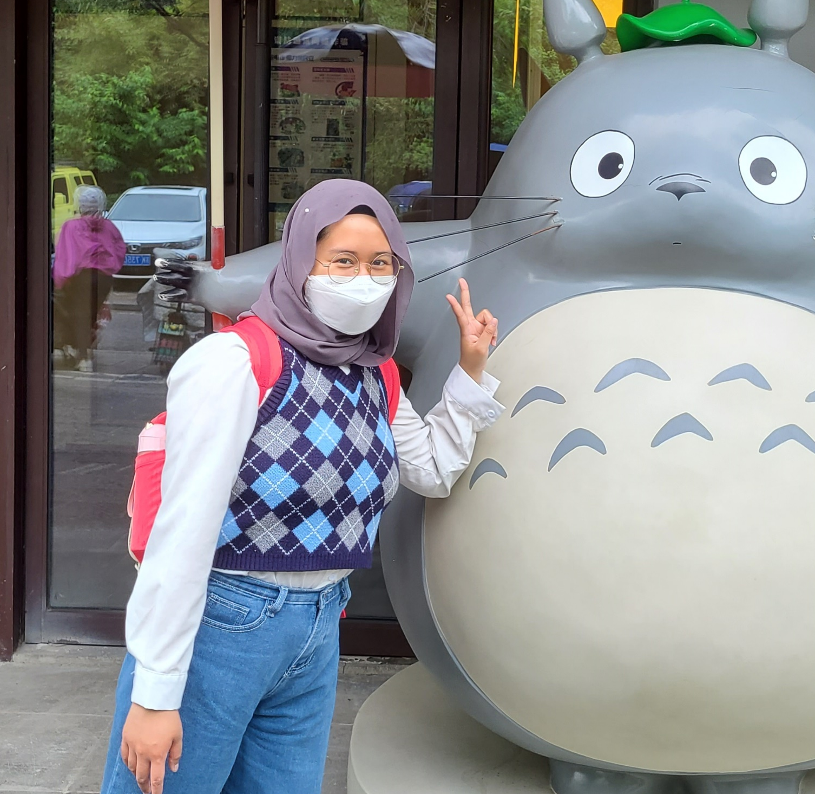
Sources
https://www.statista.com/outlook/dmo/digital-media/video-games/mobile-games/worldwide#revenue
https://www.statista.com/statistics/1308503/gacha-game-mobile-gross/
https://www.bankmycell.com/blog/mobile-gaming-industry-revenue-statistics/
Disty Mahmud
Duke/Duke Kunshan ’26
Computation and Design

Slide 9
Disty Mahmud
Thank You!
Feel free to reach out at:
aam142@duke.edu
Duke/Duke Kunshan ’26
Computation and Design

